Slide 1
Transfer Learning

Slide 2
What is a Pre-trained Model?
Simply put, a pre-trained model is a model created by some one else to solve a similar problem. Instead of building a model from scratch to solve a similar problem, you use the model trained on other problem as a starting point.
For example, if you want to build a self learning car. You can spend years to build a decent image recognition algorithm from scratch or you can take inception model (a pre-trained model) from Google which was built on ImageNet data to identify images in those pictures.
A pre-trained model may not be 100% accurate in your application, but it saves huge efforts required to re-invent the wheel.

Slide 3
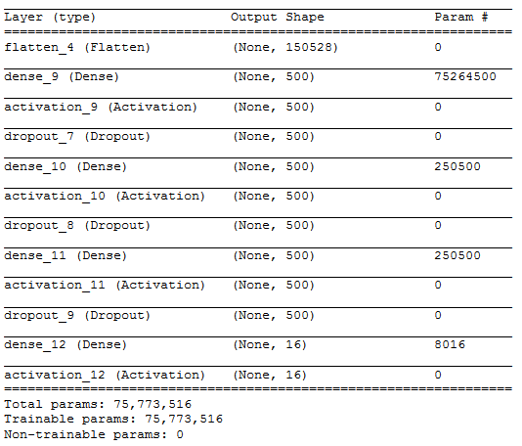
Example: MLP Model
Epoch 10/10
50/50 [==============================] – 21s – loss: 15.0100 – acc: 0.0688

Slide 4
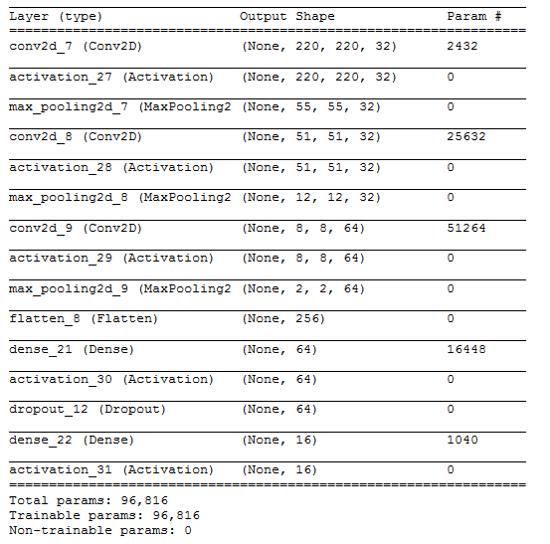
Example: CNN Model
Epoch 10/10
50/50 [==============================] – 21s – loss: 13.5733 – acc: 0.1575

Slide 5
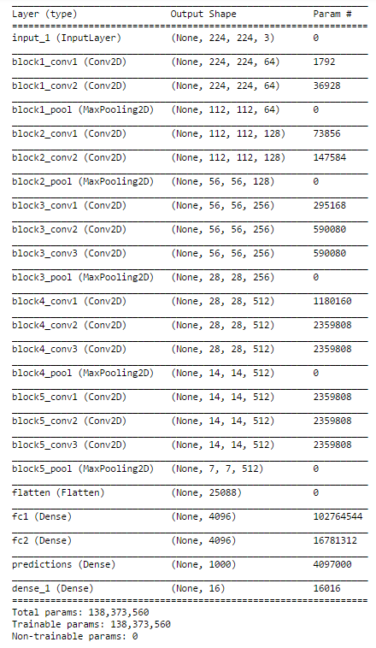
Example: VGG Architecture
The only change that has been made to the VGG16 existing architecture is changing the softmax layer with 1000 outputs to 16 categories suitable for our problem and re-training the dense layer.

Slide 6
Convolutional Neural Network
Convolutional base, which is composed by a stack of convolutional and pooling layers. The main goal of the convolutional base is to generate features from the image.
Classifier, which is usually composed by fully connected layers. The main goal of the classifier is to classify the image based on the detected features. A fully connected layer is a layer whose neurons have full connections to all activation in the previous layer.

Slide 7
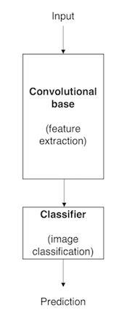
Architecture of CNN model
One important aspect of these deep learning models is that they can automatically learn hierarchical feature representations. This means that features computed by the first layer are general and can be reused in different problem domains, while features computed by the last layer are specific and depend on the chosen dataset and task.
According to Yosinski et al. (2014), ‘if first-layer features are general and last-layer features are specific, then there must be a transition from general to specific somewhere in the network’. As a result, the convolutional base of our CNN — especially its lower layers (those who are closer to the inputs) — refer to general features, whereas the classifier part, and some of the higher layers of the convolutional base, refer to specialised features.

Slide 8
How can I use Pre-trained Models?
By using pre-trained models which have been previously trained on large datasets, we can directly use the weights and architecture obtained and apply the learning on our problem statement. This is known as transfer learning. We “transfer the learning” of the pre-trained model to our specific problem statement.
We are lucky that many pre-trained architectures are directly available for us in the Keras library. Imagenet data set has been widely used to build various architectures since it is large enough (1.2M images) to create a generalized model. The problem statement is to train a model that can correctly classify the images into 1,000 separate object categories. These 1,000 image categories represent object classes that we come across in our day-to-day lives, such as species of dogs, cats, various household objects, vehicle types etc.
These pre-trained networks demonstrate a strong ability to generalize to images outside the ImageNet dataset via transfer learning. We make modifications in the pre-existing model by fine-tuning the model. Since we assume that the pre-trained network has been trained quite well, we would not want to modify the weights too soon and too much. While modifying we generally use a learning rate smaller than the one used for initially training the model.

Slide 9
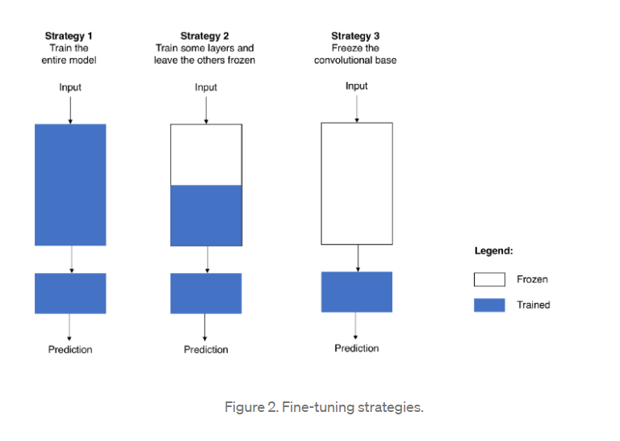
Fine-Tuning Strategies

Slide 10
Fine-Tuning Strategies
Train the entire model. In this case, you use the architecture of the pre-trained model and train it according to your dataset. You’re learning the model from scratch, so you’ll need a large dataset (and a lot of computational power).
Train some layers and leave the others frozen. As you remember, lower layers refer to general features (problem independent), while higher layers refer to specific features (problem dependent). Here, we play with that dichotomy by choosing how much we want to adjust the weights of the network (a frozen layer does not change during training). Usually, if you’ve a small dataset and a large number of parameters, you’ll leave more layers frozen to avoid overfitting. By contrast, if the dataset is large and the number of parameters is small, you can improve your model by training more layers to the new task since overfitting is not an issue.

Slide 11
Fine-Tuning Strategies
3. Freeze the convolutional base: This case corresponds to an extreme situation of the train/freeze trade-off. The main idea is to keep the convolutional base in its original form and then use its outputs to feed the classifier. You’re using the pre-trained model as a fixed feature extraction mechanism, which can be useful if you’re short on computational power, your dataset is small, and/or pre-trained model solves a problem very similar to the one you want to solve.
Unlike Strategy 3, whose application is straightforward, Strategy 1 and Strategy 2 require you to be careful with the learning rate used in the convolutional part.
The learning rate is a hyper-parameter that controls how much you adjust the weights of your network. When you’re using a pre-trained model based on CNN, it’s smart to use a small learning rate because high learning rates increase the risk of losing previous knowledge.
Assuming that the pre-trained model has been well trained, which is a fair assumption, keeping a small learning rate will ensure that you don’t distort the CNN weights too soon and too much.

Slide 12
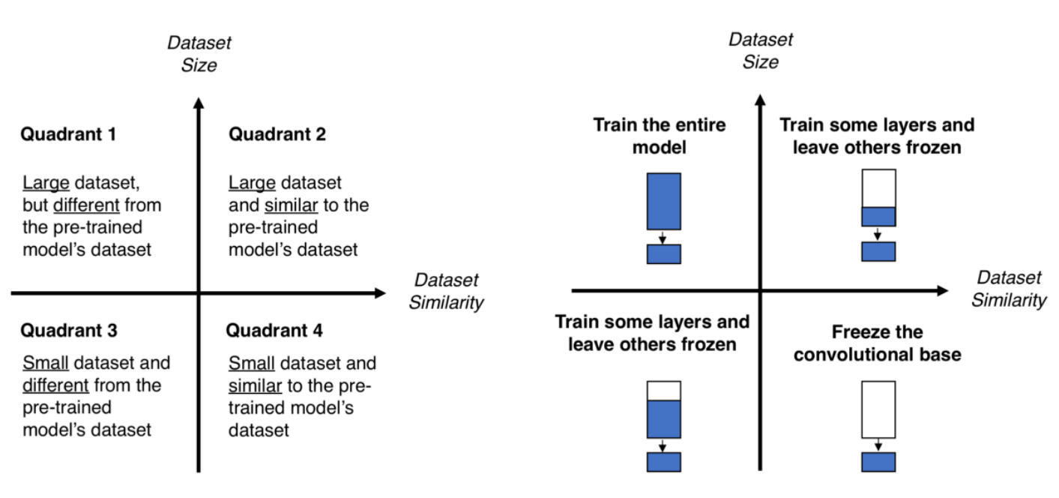
Best Strategies to follow

Slide 13
Best Strategies to follow
Quadrant 1. Large dataset, but different from the pre-trained model’s dataset. This situation will lead you to Strategy 1.
Since you have a large dataset, you’re able to train a model from scratch and do whatever you want.
Despite the dataset dissimilarity, in practice, it can still be useful to initialise your model from a pre-trained model, using its architecture and weights.

Slide 14
Best Strategies to follow
Quadrant 2. Large dataset and similar to the pre-trained model’s dataset. Here you’re in la-la land. Any option works. Probably, the most efficient option is Strategy 2.
Since we have a large dataset, overfitting shouldn’t be an issue, so we can learn as much as we want. However, since the datasets are similar, we can save ourselves from a huge training effort by leveraging previous knowledge.
Therefore, it should be enough to train the classifier and the top layers of the convolutional base.

Slide 15
Best Strategies to follow
Quadrant 3. Small dataset and different from the pre-trained model’s dataset. This is the 2–7 off-suit hand of computer vision problems. Everything is against you. If complaining is not an option, the only hope you have is Strategy 2.
It will be hard to find a balance between the number of layers to train and freeze. If you go to deep your model can overfit, if you stay in the shallow end of your model you won’t learn anything useful.
Probably, you’ll need to go deeper than in Quadrant 2 and you’ll need to consider data augmentation techniques.

Slide 16
Best Strategies to follow
Quadrant 4. Small dataset, but similar to the pre-trained model’s dataset. I asked Master Yoda about this one he told me that ‘be the best option, Strategy 3 should’.
I don’t know about you, but I don’t underestimate the Force. Accordingly, go for Strategy 3. You just need to remove the last fully-connected layer (output layer), run the pre-trained model as a fixed feature extractor, and then use the resulting features to train a new classifier.

Slide 17
Loss Function

Slide 18
MultiClass Vs MultiLabel
A classification task with more than two classes; e.g., classify a set of images of fruits which may be oranges, apples, or pears. Multi-class classification makes the assumption that each sample is assigned to one and only one label: a fruit can be either an apple or a pear but not both at the same time.
Multi-label classification originated from the investigation of text categorization problem, where each document may belong to several predefined topics simultaneously.

Slide 19
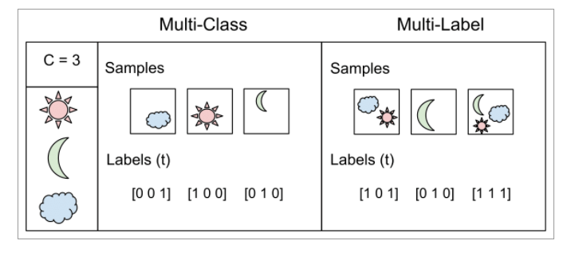
MultiClass Vs MultiLabel
Difference between multi-class classification & multi-label classification is that in multi-class problems the classes are mutually exclusive, whereas for multi-label problems each label represents a different classification task, but the tasks are somehow related.
For example, multi-class classification makes the assumption that each sample is assigned to one and only one label: a fruit can be either an apple or a pear but not both at the same time. Whereas, an instance of multi-label classification can be that a text might be about any of religion, politics, finance or education at the same time or none of these.

Slide 20

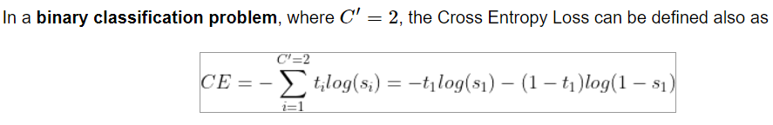
Cross-Entropy loss
The Cross-Entropy Loss is actually the only loss we are discussing here. The other losses names written in the title are other names or variations of it. The CE Loss is defined as:
Where ti and si are the groundtruth and the CNN score for each class i in C. As usually an activation function (Sigmoid / Softmax) is applied to the scores before the CE Loss computation, we write f(si) to refer to the activations.

Slide 21
Contd…
Logistic Loss and Multinomial Logistic Loss are other names for Cross-Entropy loss.
The layers of Caffe, Pytorch and Tensorflow than use a Cross-Entropy loss without an embedded activation function are:
Caffe: Multinomial Logistic Loss Layer. Is limited to multi-class classification (does not support multiple labels).
Pytorch: BCELoss. Is limited to binary classification (between two classes).
TensorFlow: log_loss.

Slide 22
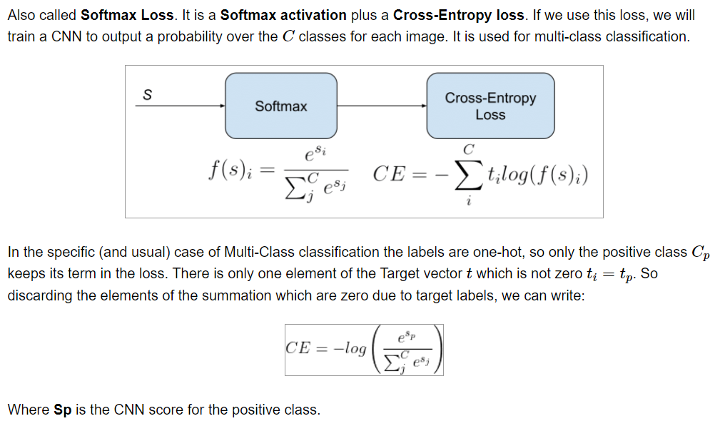
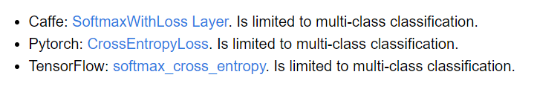
Categorical Cross-Entropy loss

Slide 23
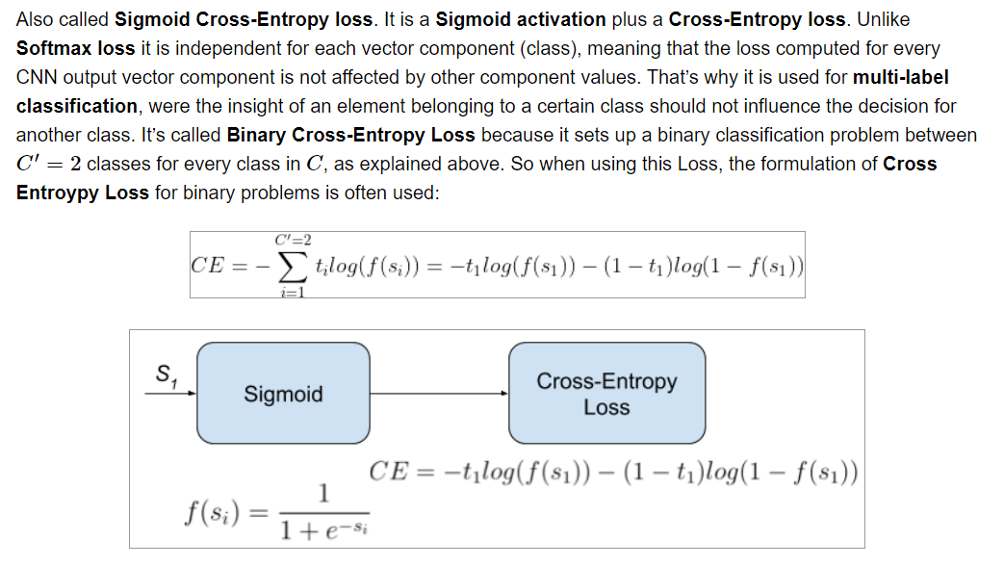
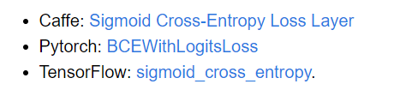
Binary Cross-Entropy Loss

Slide 24
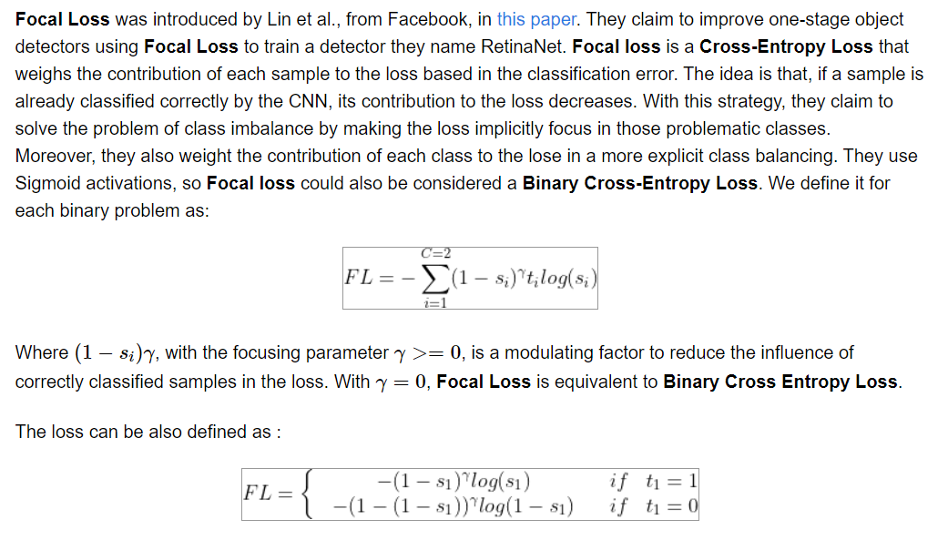
Focal Loss

Slide 25
Optimizing Function

Slide 26
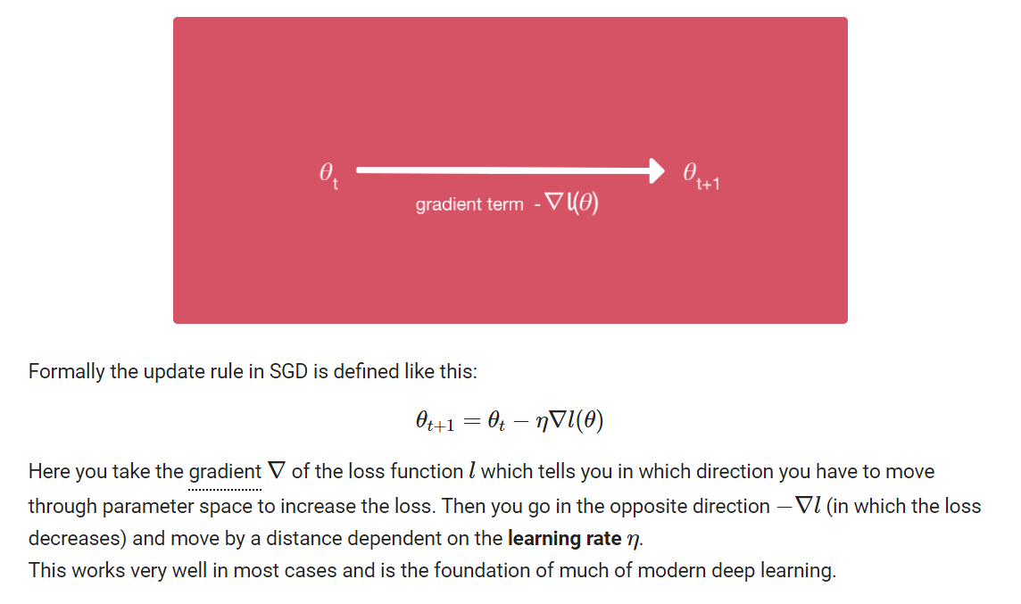
Gradient Descent

Slide 27
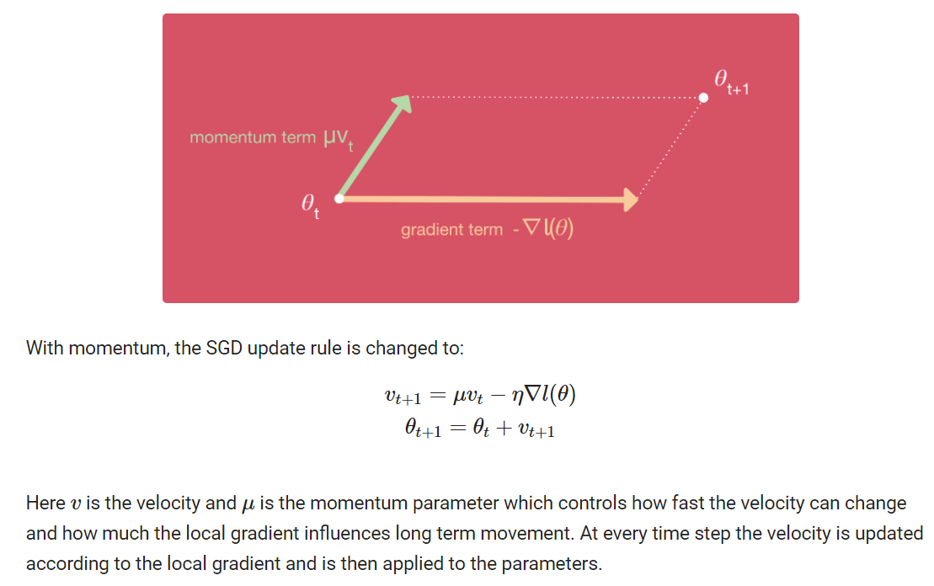
Gradient Descent with momentum

Slide 28
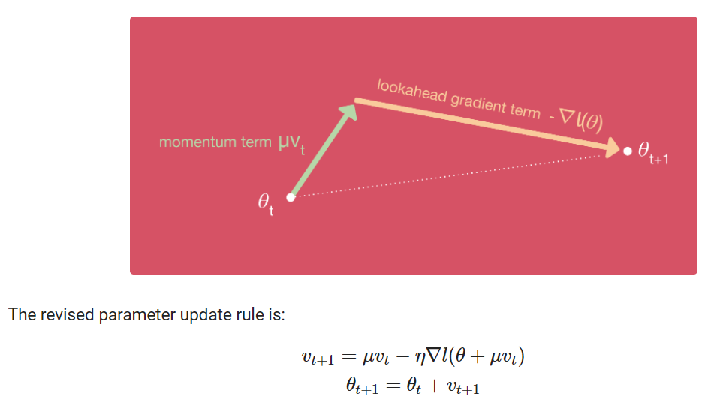
Gradient Descent with Nesterov Momentum

Slide 29
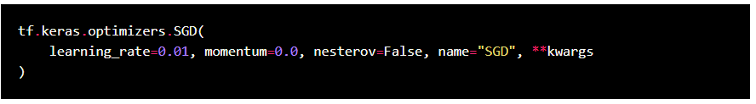
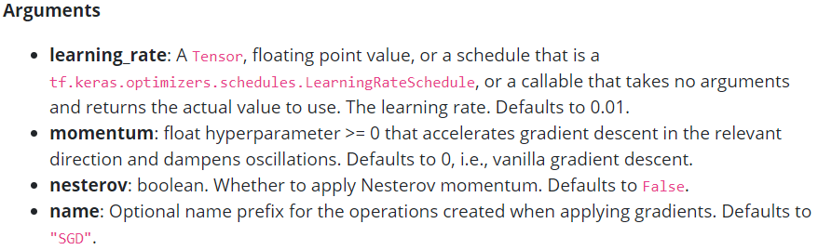
Gradient Descent
Gradient Descent with Momentum considers the past gradients to smooth out the update. ... It computes an exponentially weighted average of your gradients, and then use that gradient to update your weights instead. It works faster than the standard gradient descent algorithm.

Slide 30
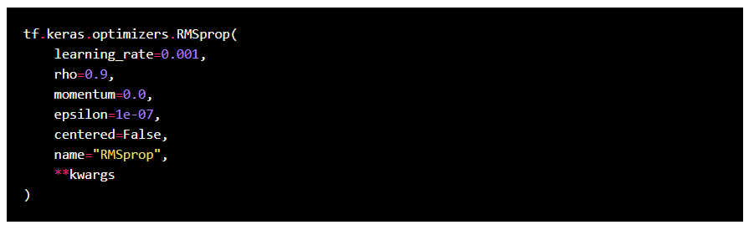
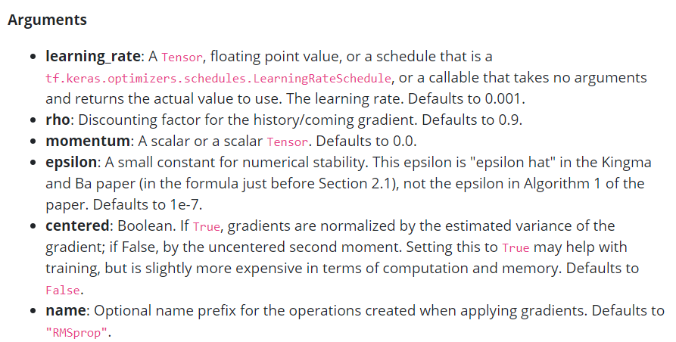
RMSprop

Slide 31
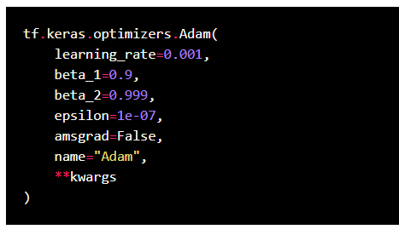
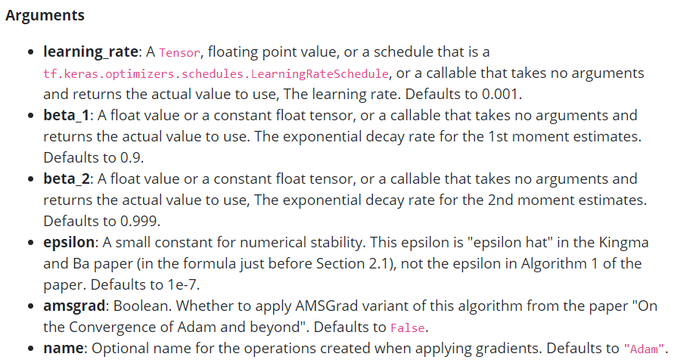
ADAM

Slide 32
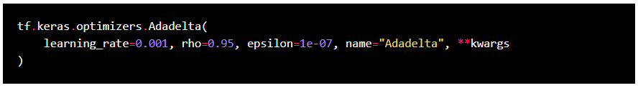
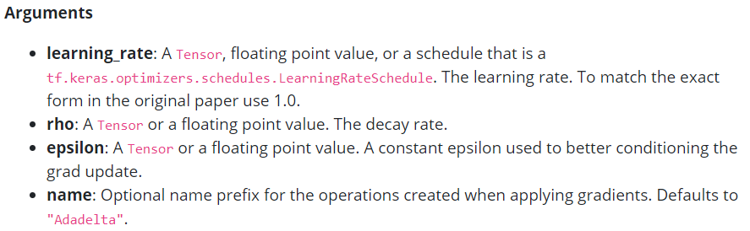
Adadelta

Slide 33
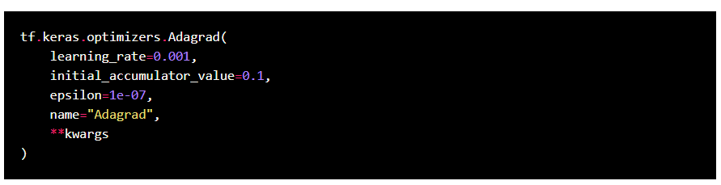
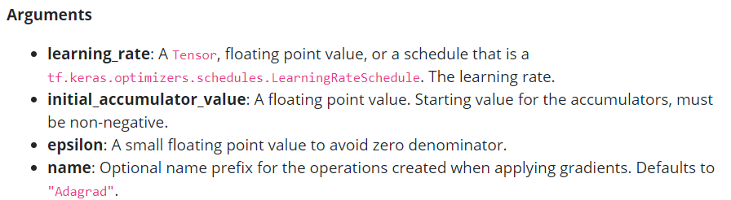
Adagrad

Slide 34
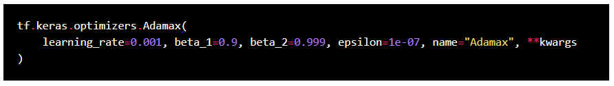
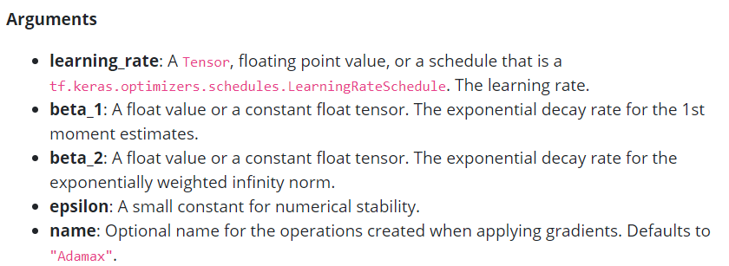
Adamax

Slide 35
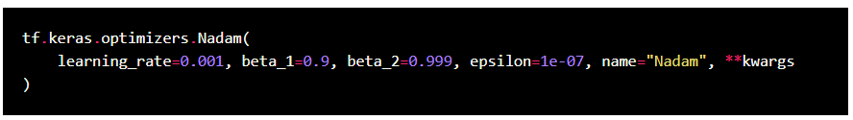
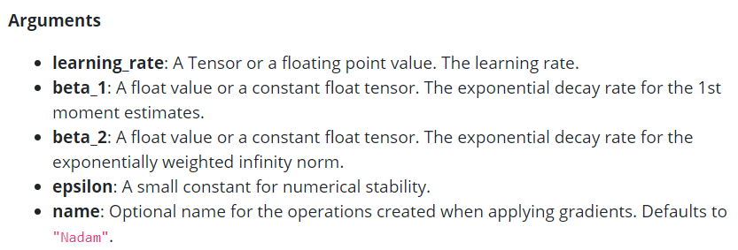
NAdam

Slide 36
Thank You

